Slide 1
IMPLEMENT INFIX TO POSTFIX CONVERSION USING STACK IN C
DATA STRUCTURE & ALGORITHM PROJECT
Guided by Mrs. SONAM MODI
MEMBER NAME
ENROLLMENT NUMBER:- 216400307127
NAME:- SOLANKI TRUSHEN
ENROLLMENT NUMBER:- 216400307129
NAME:- PITRODA RUDRA
ENROLLMENT NUMBER:- 216400307125
NAME:- RATHOD ROHIT
ENROLLMENT NUMBER:- 216400307118
NAME:- BHAVSAR DAKSH

Slide 2
INDEX
SR NO. | TOPIC NAME | PAGE NO.
1 | General | 3
2 | Infix to Postfix convert | 4
3 | Advantages of Postfix expression | 5
4 | Algorithm of convert Infix to Postfix | 6
5 | Infix to Postfix conversion | 7
6 | Code screenshot | 8-9
7 | Output screenshot | 10

Slide 3
General
One of the applications of Stack is in the conversion of arithmetic expressions in high-level programming languages into machine readable form. As our computer system can only understand and work on a binary language, it assumes that an arithmetic operation can take place in two operands only e.g., A+B, C*D,D/A etc. But in our usual form an arithmetic expression may consist of more than one operator and two operands e.g. (A+B)*C(D/(J+D)).
These complex arithmetic operations can be converted into polish notation using stacks which then can be executed in two operands and an operator form.

Slide 4
Infix & Postfix
Infix Expression
It follows the scheme of <operand><operator><operand> i.e. an <operator> is preceded and succeeded by an <operand>. Such an expression is termed infix expression. E.g., A+B
Postfix Expression
It follows the scheme of <operand><operand><operator> i.e. an <operator> is succeeded by both the <operand>. E.g., AB+

Slide 5
Advantage of Postfix Expression
Advantage of Postfix Expression over Infix Expression
An infix expression is difficult for the machine to know and keep track of precedence of operators. On the other hand, a postfix expression itself determines the precedence of operators (as the placement of operators in a postfix expression depends upon its precedence).Therefore, for the machine it is easier to carry out a postfix expression than an infix expression.

Slide 6
Algorithm to convert Infix To Postfix
Let, X is an arithmetic expression written in infix notation. This algorithm finds the equivalent postfix expression Y.
Push “(“onto Stack, and add “)” to the end of X.
Scan X from left to right and repeat Step 3 to 6 for each element of X until the Stack is empty.
If an operand is encountered, add it to Y.
If a left parenthesis is encountered, push it onto Stack.
If an operator is encountered ,then:
Repeatedly pop from Stack and add to Y each operator (on the top of Stack) which has the same precedence as or higher precedence than operator.
Add operator to Stack. [End of If]
If a right parenthesis is encountered ,then:
Repeatedly pop from Stack and add to Y each operator (on the top of Stack) until a left parenthesis is encountered.
Remove the left Parenthesis. [End of If] [End of If]

Slide 7
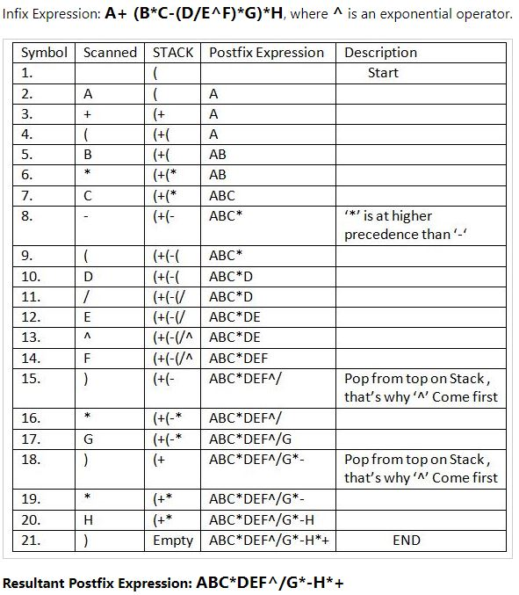
Infix to Postfix conversion

Slide 8
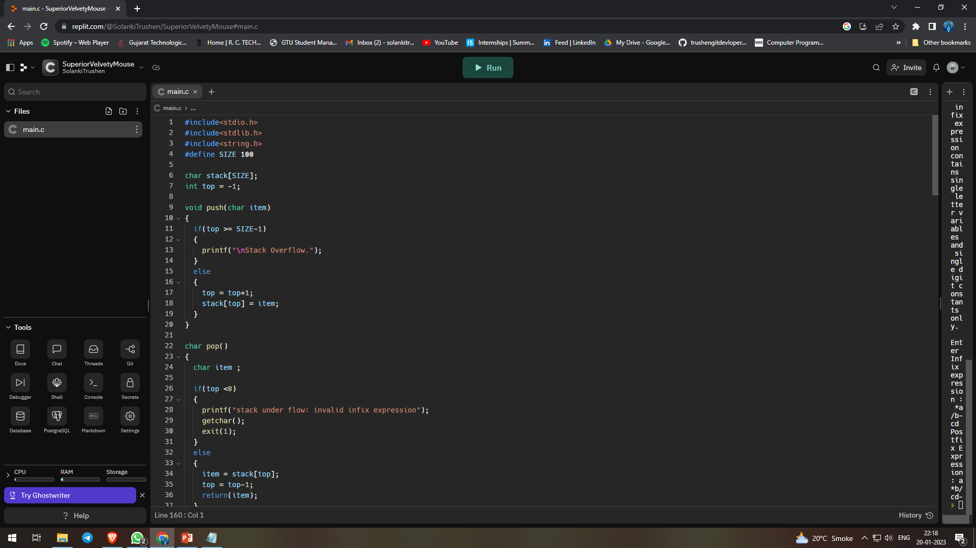
Code screen shot

Slide 9
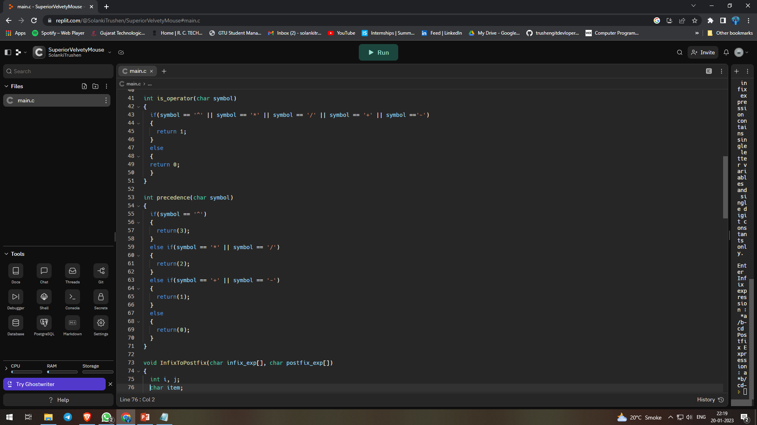
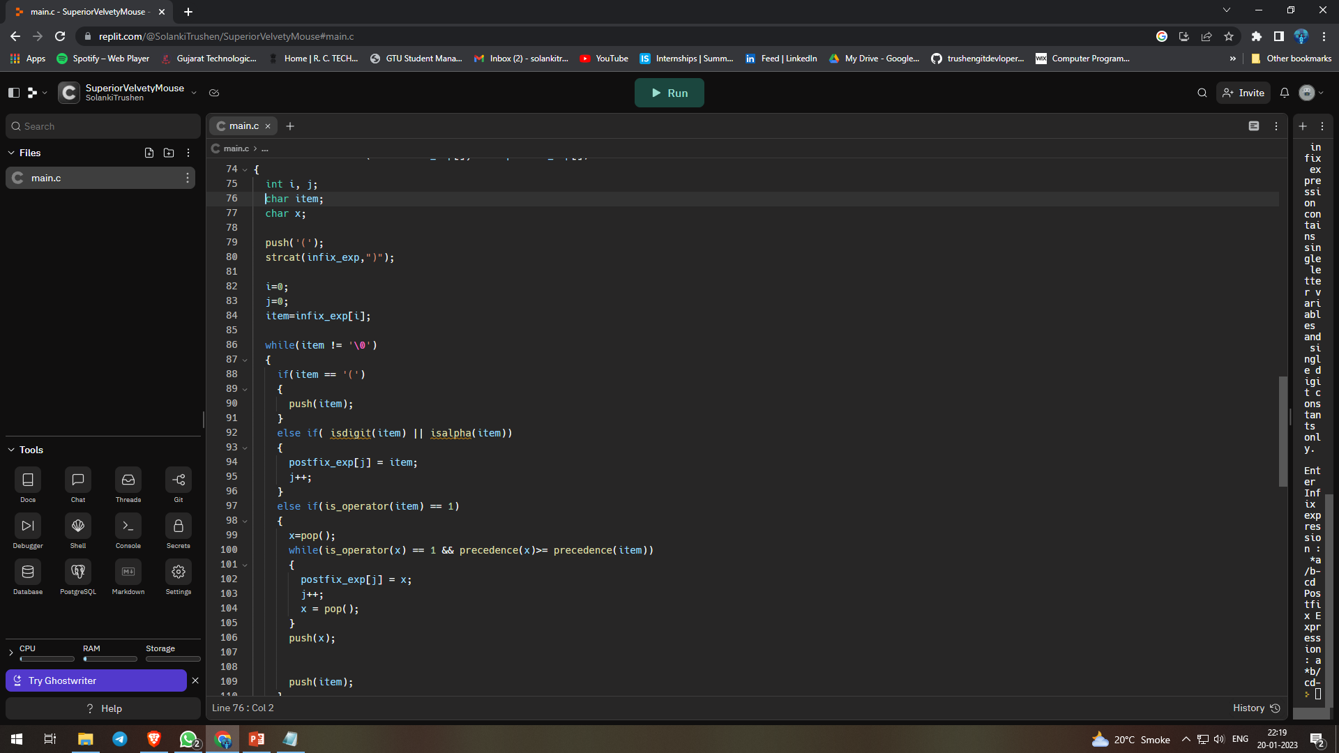

Slide 10
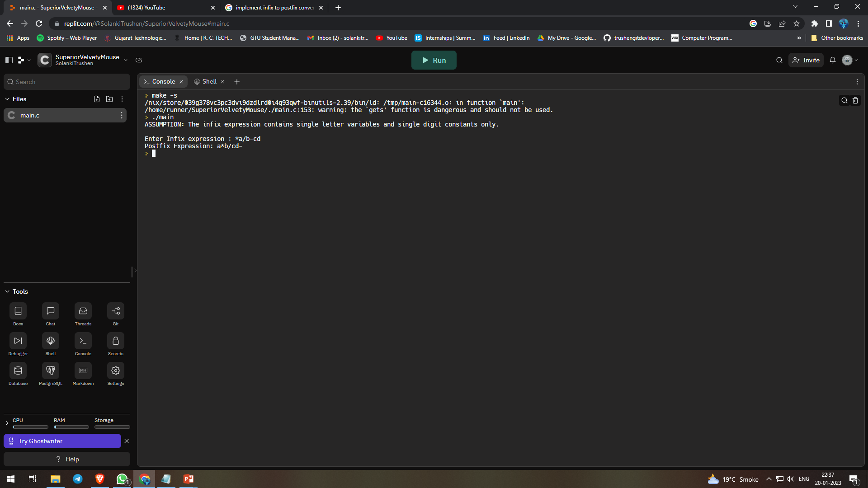
Output screen shot

